Slide 1

PREDICTING SLEEP DISORDERS USING LIFESTYLE AND HEALTH FACTORS
PRESENTED BY:
MARCELINO C. GATCHALIAN III
TEHRENCE JOIE C. LLENAREZ
JAMES CEDRICK P. VILLANUEVA

Slide 2
TABLE OF CONTENTS
01 INTRODUCTION
04 RESULT AND DISCUSSION
02 RELATED WORK
05 LIMITATION AND FUTURE WORK
03 DATA AND METHODOLOGY
06 CONCLUSION

Slide 3
INTRODUCTION
Sleep disorders impact millions of individuals worldwide,
leading to significant public health concerns and economic
implications. The interplay between lifestyle factors (e.g.,
stress, physical activity) and physiological conditions (e.g.,
BMI, blood pressure) often contributes to sleep disruptions.
Machine learning models, particularly the Random Forest algorithm, offer robust classification capabilities that can handle diverse input features and reveal important predictors.

Slide 4
INTRODUCTION
Significance of Sleep Disorders:
Sleep disorders are a global issue impacting health, productivity, and economies.
Objective of Study:
aiming to enhance preventive care strategies through reliable, data-driven insights into lifestyle and health influences on sleep quality
Model Choice:
Uses Random Forest due to its strong classification performance.

Slide 5
RELATED WORK
A growing body of research has utilized machine learning to predict health outcomes based on lifestyle and physiological data. Onargan et al. [1] applied logistic regression to assess sleep apnea risk factors, highlighting associations between sleep patterns and biometric indicators. Similarly, Widasari et al. [2] employed Support Vector Machines (SVM) for sleep disorder classification, demonstrating the efficacy of machine learning in identifying complex relationships within health data.

Slide 6
RELATED WORK
Studies have shown that machine learning models, like logistic regression and support vector machines, can be used for health predictions, including sleep-related issues.
Logistic Regression: Applied to identify sleep apnea risk by assessing biometric indicators.
Support Vector Machines (SVM): Effective in identifying patterns within sleep disorder classifications.
The researchers uses a comprehensive dataset that includes both lifestyle and health metrics, combined with the Random Forest algorithm for better accuracy.

Slide 7

DATA AND METHODOLOGY
Dataset:
Age, Gender, Occupation, Sleep Duration, Quality of Sleep, Physical Activity Level, Stress Level, BMI, Blood Pressure, Heart Rate, Daily Steps.
Data preprocessing:
Data preprocessing involved handling missing values, encoding categorical features, and normalizing numerical values. The dataset was then split into training and testing sets for evaluation.
Algorithms and evaluation metrics:
K-Nearest Neighbors (KNN), Logistic Regression, Gaussian Naive Bayes, Support Vector Classifier, Decision Tree, and Random Forest.

Slide 8
DATA AND METHODOLOGY
Model
Random Forest Balanced performance, handling diverse data, and providing insights into feature importance.
The researchers chose the Random Forest model for this study due to its superior accuracy. After evaluating multiple machine learning techniques, they found that Random Forest consistently produced reliable and precise results. Additionally, the researchers identified Random Forest as the suitable and viable model for this particular research because of its ability to handle large datasets, manage complex relationships between variables, and provide interpretable results. These attributes make it especially well-suited for the research objectives, where both prediction accuracy and model robustness are essential for drawing meaningful conclusions.

Slide 9
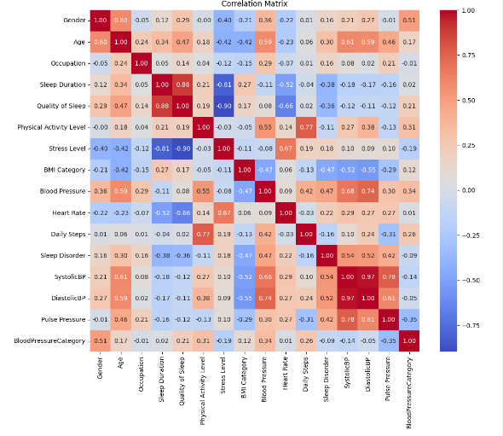
RESULTS AND DISCUSSION
Correlation Matrix
This matrix shows the strength and direction of linear relationships between features. For instance, Sleep Duration and Quality of Sleep show a strong positive correlation, indicating that higher sleep quality is associated with longer sleep duration.
Positive correlation between Sleep Duration and Quality of Sleep:
Longer sleep tends to correlate with better sleep quality.
Other significant relationships may include stress level with sleep duration, blood pressure with BMI, etc.

Slide 10
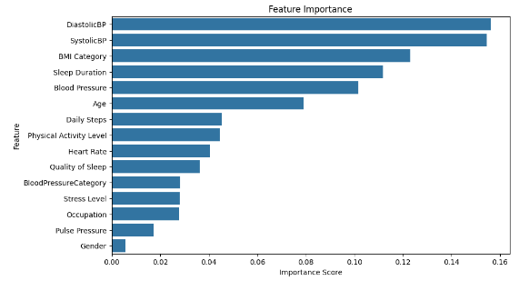
FEATURE IMPORTANCE IN RANDOM FOREST MODEL
Most influential Features Identified:
Blood Pressure, BMI, Sleep Duration.
Why These Features Matter:
Blood Pressure and BMI are critical health indicators, while Sleep Duration directly relates to sleep quality.
Model Insight:
The model assigns importance to features, revealing which predictors most significantly impact sleep disorder risk.

Slide 11
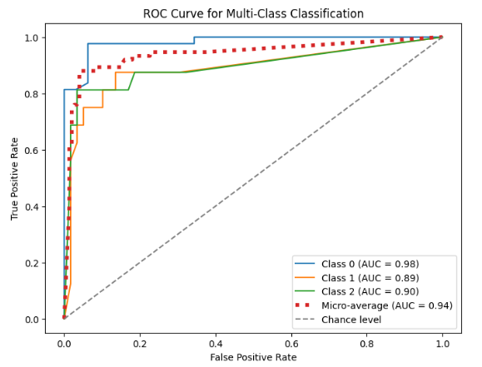
MODEL PERFORMANCE
The Random Forest model achieved the following metrics:
Accuracy: 0.88
Precision: 0.8819
Recall: 0.88
F1-Score: 0.8785
ROC AUC: 0.88
To evaluate the model’s ability to discriminate between classes, the researchers analyzed the Receiver Operating Chartacteristic (ROC) curve and calculated the Area Under the Curve (AUC) score. The ROC AUC score for the Random Forest model was 0.88, indicating a strong ability to distintguish between individuals with and without sleep disorders.

Slide 12
LIMITATIONS AND FUTURE WORK
Limitations:
Limited sample size restricts generalizability of the model’s performance to larger, more diverse populations.
Future Work:
Expanding the dataset to include more diverse demographic and lifestyle factors could further enhance the model’s predictive capability

Slide 13
CONCLUSION
Summary of Findings:
Health and lifestyle factors can effectively predict sleep disorder risk.
Random Forest model helps identify top predictors, which can inform health interventions.
Using machine learning in health can guide individuals in modifying risk factors (e.g., lowering stress, managing blood pressure).

